Slide 1
Elbirt Technologies Software Suite
The Next Generation in Data Visualization and Analysis using Network Analysis Methodology
Benjamin Elbirt
http://www.elbirttechnologies.com
November 5, 2010

Slide 2
Special Thanks
Dr. Noshir Contractor – Invitation
Marilyn Logan & Meikuan Huang – Remote Presentation Setup
Dr. George Barnett, Dr. James Fowler & INSNA - Data

Slide 3
Presentation Overview
A Keyword Quickie
Obtaining the Software
M2C 4.0 – Creating the MDS Coordinates for ET-V
Conversion of Raw Data to Coordinates using Structural Equivalence (SE) and Multidimensional Scaling (MDS) methodologies
Procrustes Rotation for Longitudinal or Optimal Choice Analysis
Centrality Calculations
The GUI Interface
The Input File
Outputs
ET-V 1.0 – Visual Complexity with Complex Data
The GUI Interface
Intonation and Animation of Longitudinal Data
Examples
Canadian Migration Patterns (Barnett & Sung, 2003)
US Senate Co-sponsorship Networks (Fowler, 2010)
Sunbelt Conference Co-authorship Networks
Bibliography
Q&A

Slide 4
A Keyword Quickie
Token, Object, Entity, Element, Word, Node – These refer to the individual things being studied.
Edge, Relation - These refer to the non-zero value relating two objects.
Set, System, Matrix, Network, Space – These refer to the collection of objects being studied.

Slide 5
Obtaining the Software
Where:
Website : http://www.elbirttechnologies.com
Cost : $ 0.00 – FREE
Requirements
Java Runtime Environment (latest)
Windows OS
Installation
Unzip the downloaded file.
Run the unzipped JAR file to start the installation process.
Installation Notes
Make sure your Java installation matches your OS bit type.
No System Changes Made – Just delete the install directory!

Slide 6
Matrix to Coordinates 4.0
Converting data to coordinate systems has never been so simple.

Slide 7
Matrix to Coordinates 4.0 Conversion of Raw Data to Coordinates using Structural Equivalence (SE) and Multidimensional Scaling (MDS) methodologies.
MDS Requires the input data be a symmetrical relative distance matrix.
The SE Solution
Uses the Pythagorean theorem to create distances.
Uses the squared difference between values to determine distance (accommodates +/- values) while returning a final + value (distance).
Considers both row and column values for each element in the matrix as they relate to the row and column values of another object (accommodates symmetry and directed).
Creates a structural similarity matrix where the larger the resulting value the more distance exists (structurally) between the objects – Exactly what MDS wants.
MDS produced results without consideration for the previous (time series) data set. Hence the need for Procrustes rotation.
Input Data Variation
Symmetrical vs. Directed
Values not measured as distances.
Positive and Negative Values

Slide 8
Matrix to Coordinates 4.0 Procrustes Rotation for Longitudinal or Optimal Choice Analysis
Custom Solution
Rotates the Entire Space based on Shared Labels
Optimal Choice solution for non-longitudinal comparison analysis.
Time Series solution for longitudinal analysis.
Scaling as part of rotation optional.
Time Series Rotation
Optimal Choice Rotation
Rotates to the previous data set coordinates.
Determine the dataset that shares the most concepts with the current data set.

Slide 9
Matrix to Coordinates 4.0
Without Rotation
With Rotation

Slide 10
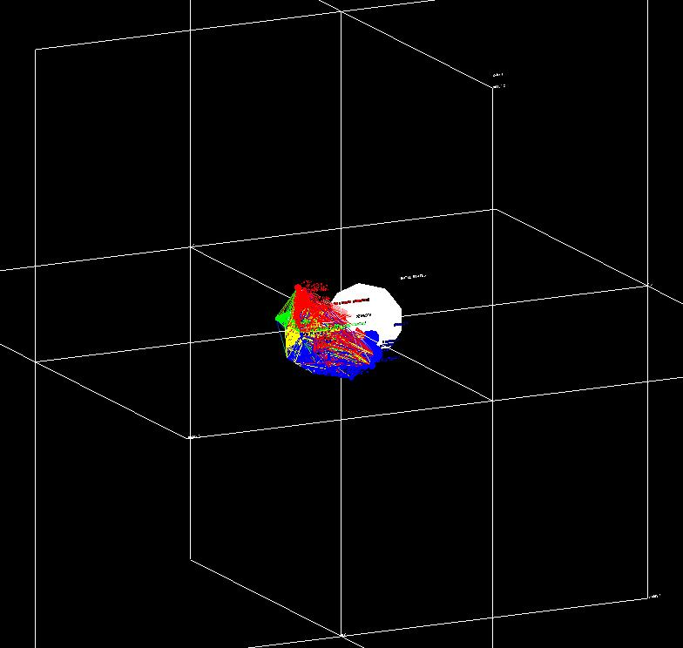
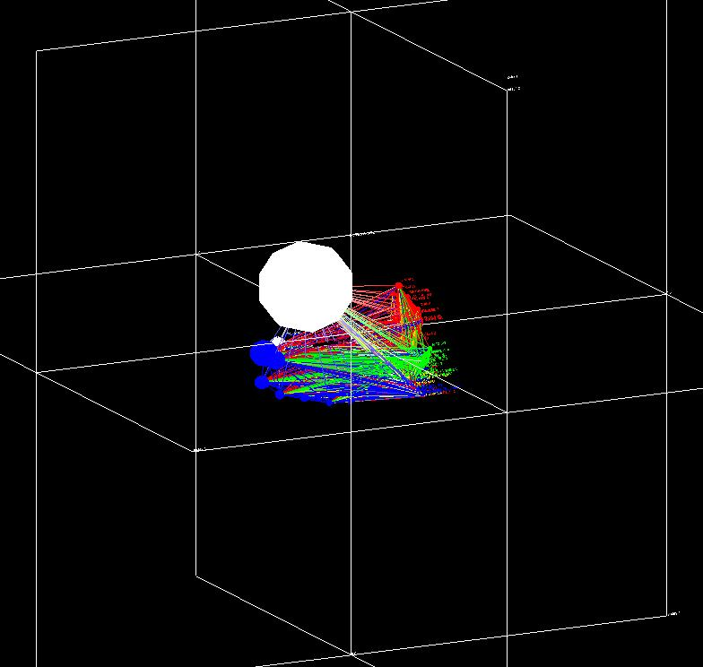
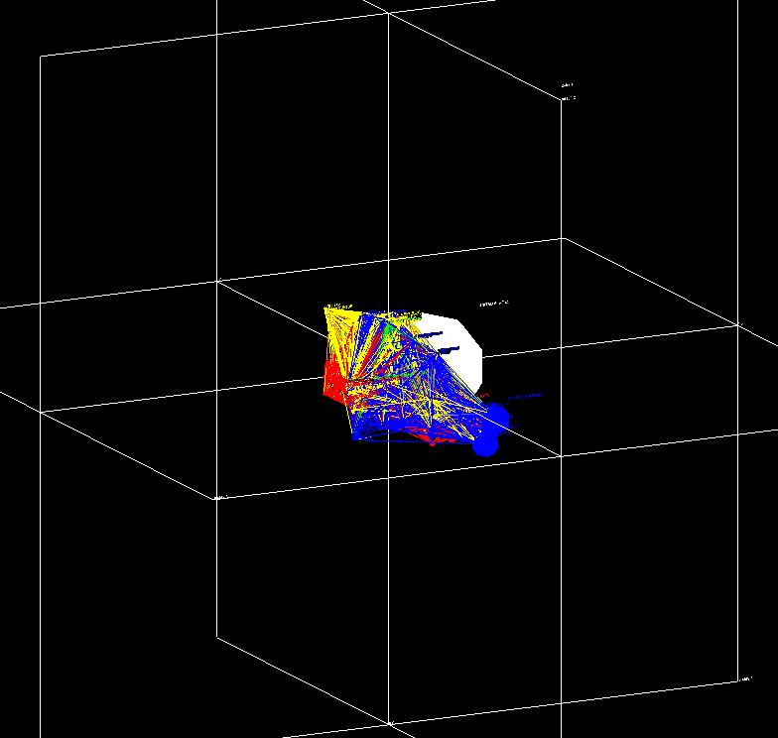
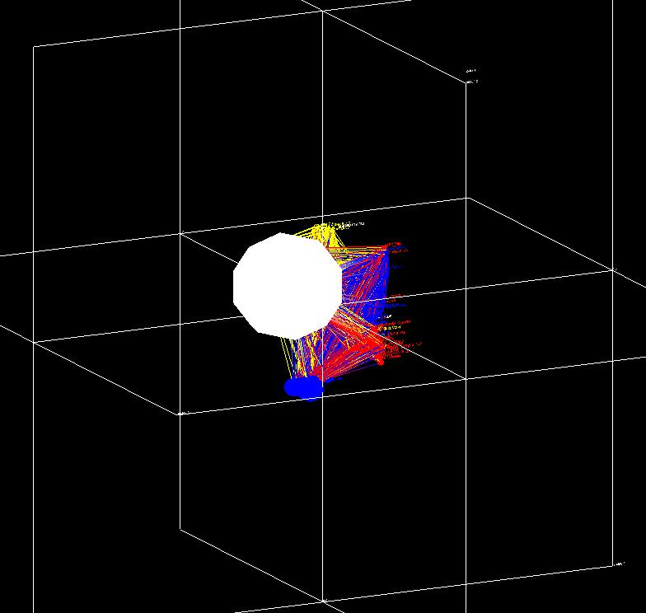
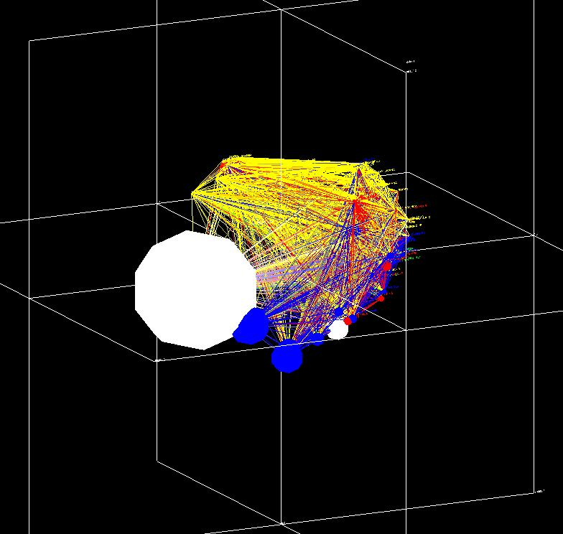
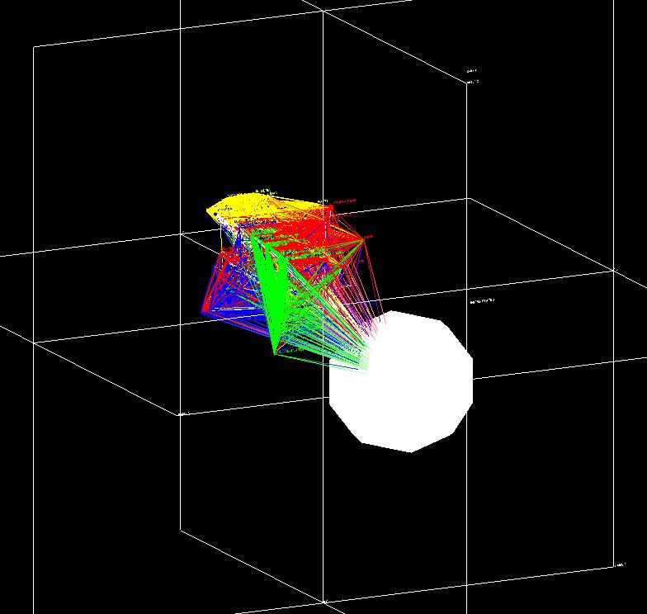
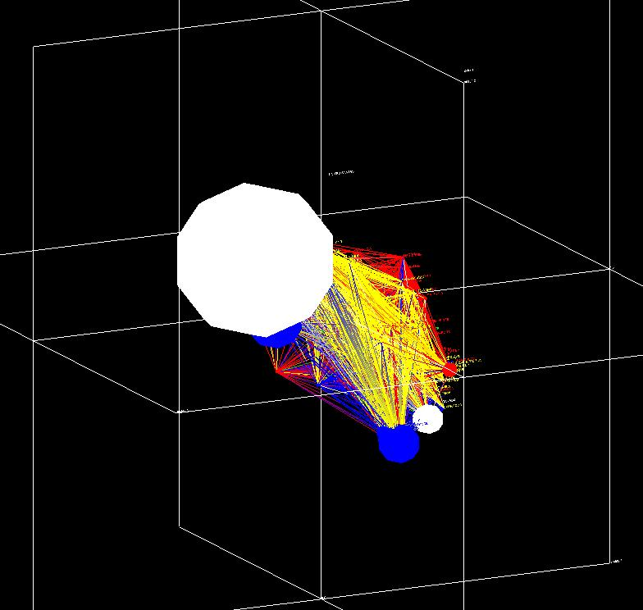
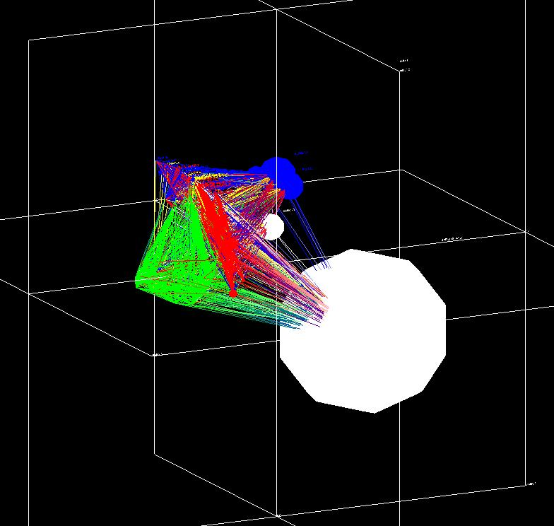
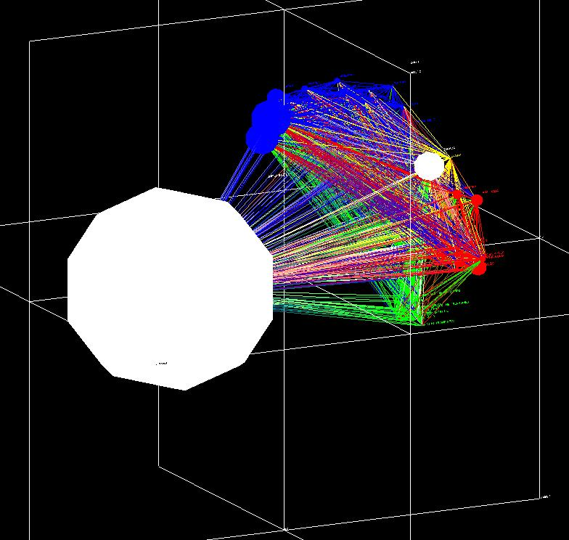
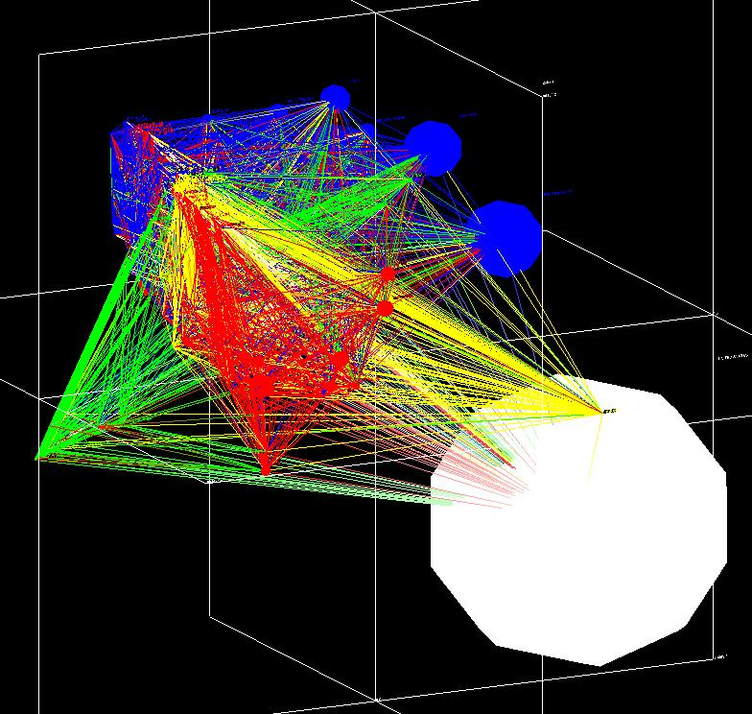
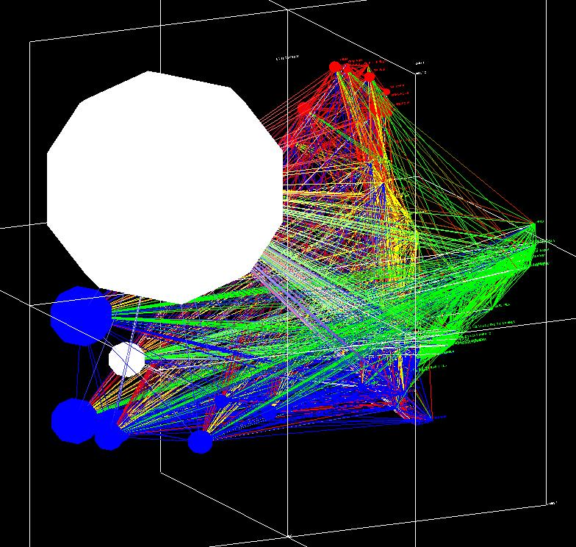
No Rotation

Slide 11
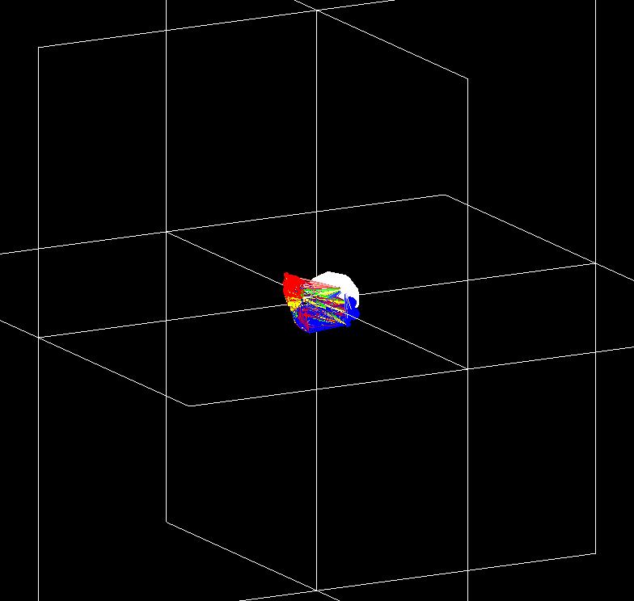
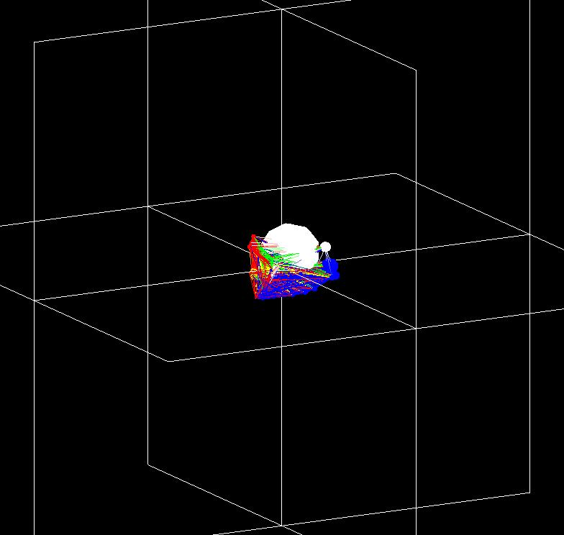
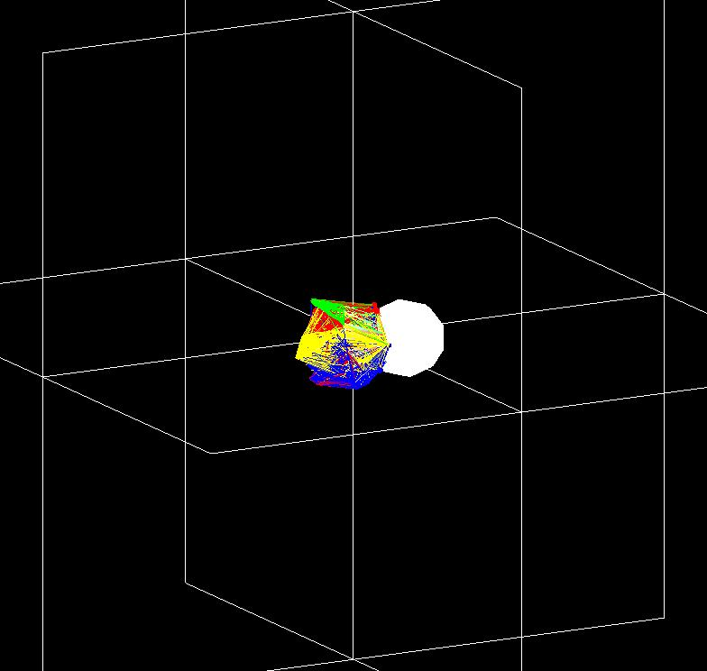
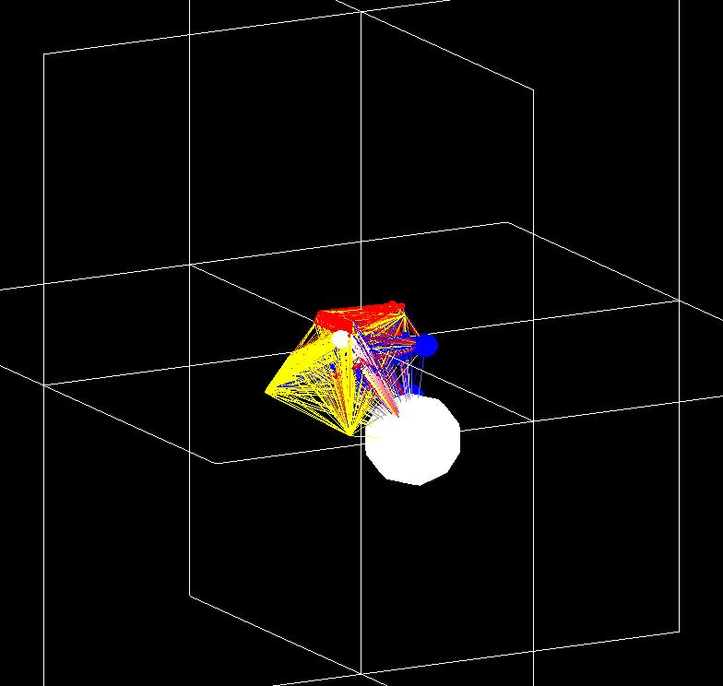
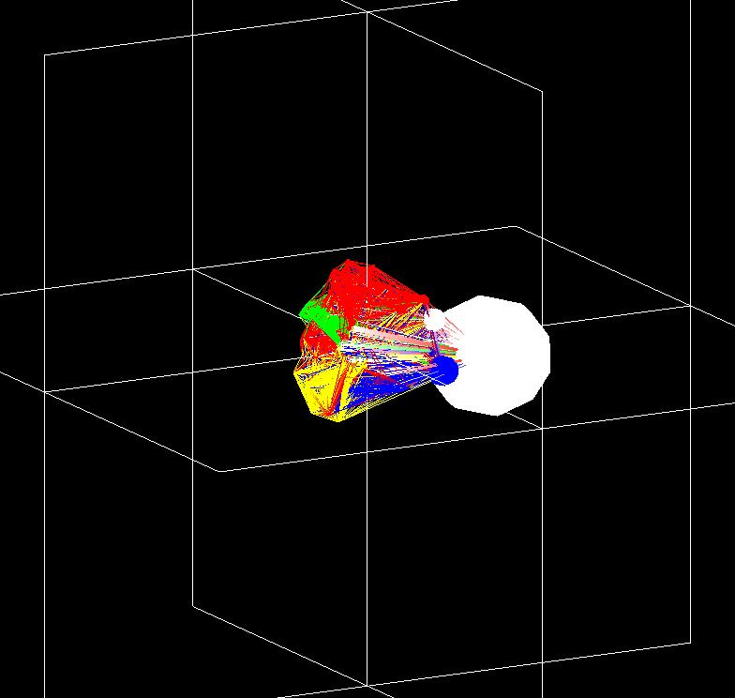
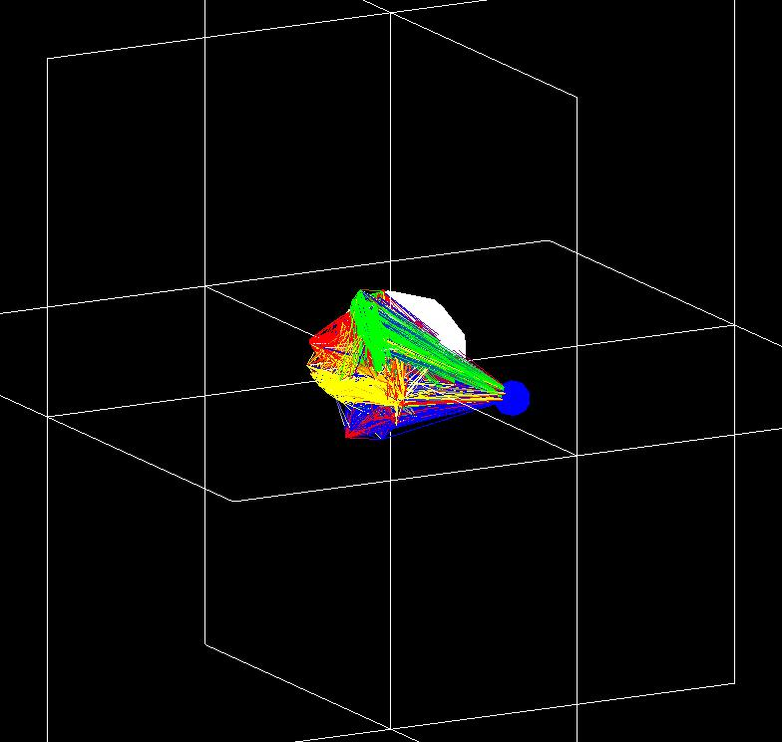
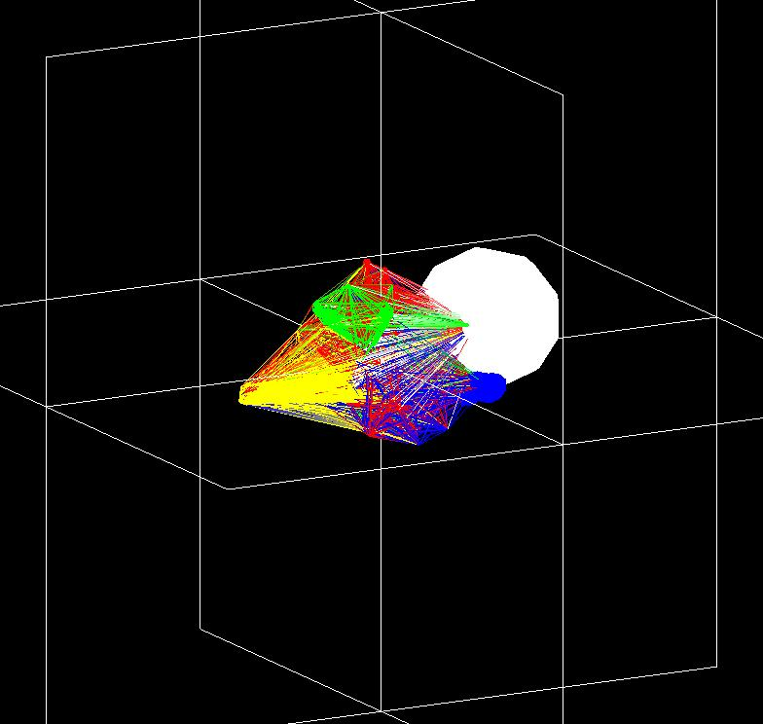
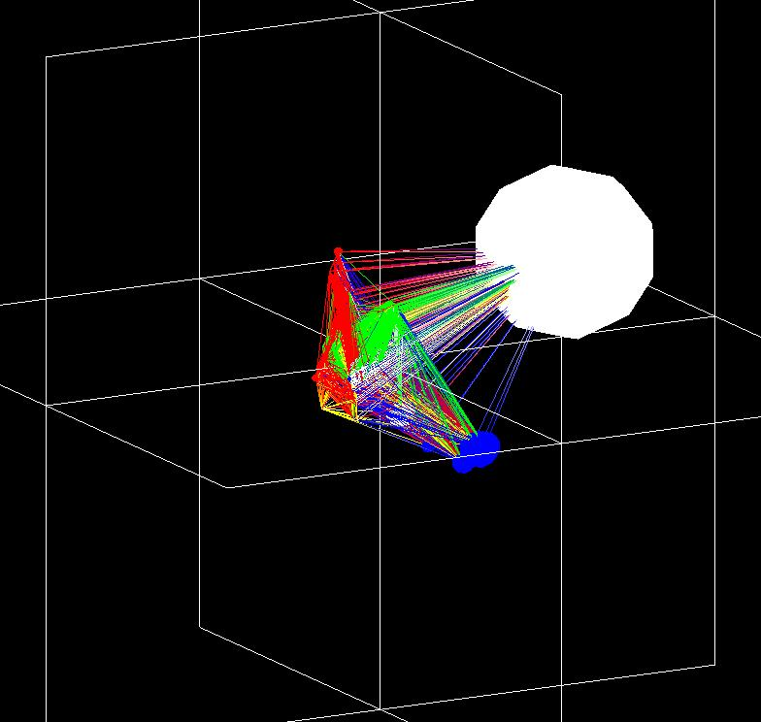
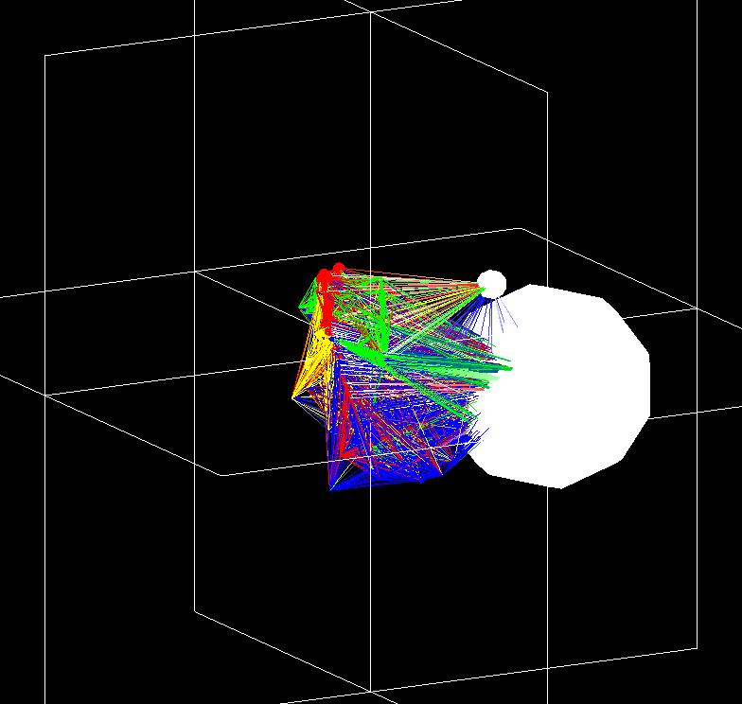
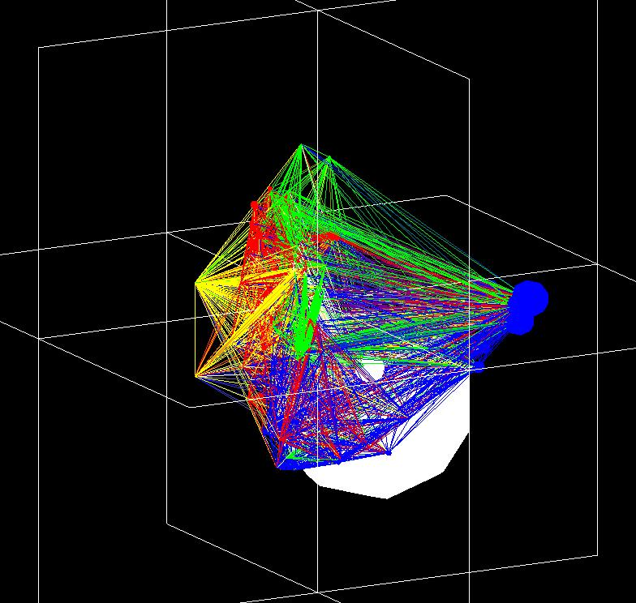
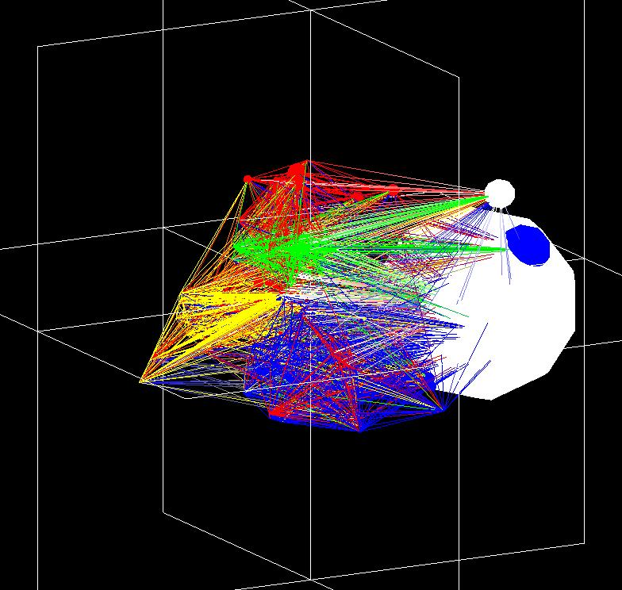
Rotated

Slide 12
Matrix to Coordinates 4.0 Centrality Calculations
JUNG - Java Universal Network/Graph (Madadhain, 2005)
Binary/Weighted Sum/Average Distance Centrality
Binary/Weighted Betweenness Centrality
Binary/Weighted Closeness Centrality
Binary/Weighted Sum/Normalized In/Out Degree Centrality
Normalized considers Reflexivity
Weighted Sum considers MAX(DC)

Slide 13
Matrix to Coordinates 4.0 The GUI Interface
Project Menu
New/Load/Save project configurations.
Input Files Menu
Add/Remove/Reorder
Set Delimiter
Configurations Menu
Rotation Controls
Output Controls
Centrality Calculations
Help / Documentation
Manual included with software.

Slide 14
Matrix to Coordinates 4.0 The Input File
Delimited, XLS, XLSX
Tab or Comma delimited
Microsoft Excel and Excel XML files
Relation Pairs
Empty strengths = 1.0 (Binary)
Smallest Data File
Relation Matrix
Classic Input Files for Backward Compatibility and Cross Application Use
Multiple Files / Spreadsheets
Each Spreadsheet considered a file
Each File/Spreadsheet specifies input type for mixed usage.

Slide 15
Matrix to Coordinates 4.0 Outputs
Outputs are in Microsoft Excel XLSX™ files and include a coordinate file, time series file, Elbirt Technologies Visualizer (ET-V) data file, structural equivalence pair data file and coordinate to structural-equivalence error values.
A dialogue window will appear asking for the directory to put the output files after selecting the Run option.
A directory named M2COutput will be created within the directory specified to hold all the files created by the application. A numerical index will be added if this directory already exists; i.e. M2COutput1.
Each file will contain a spreadsheet with the relevant information for each data set found among all the files. The spreadsheets are named based on the naming used in the input files or the input file name itself when using text files.
Coordinate File
This file contains the coordinates that result from the MDS and Procrustes rotation.
Time Series File
This file contains the coordinate data for each object as it appears in each file.
Time series analysis/graphing for change over datasets (time) can be done with this data.
ET-V Data File
This is a default ET-V data file for use with the Elbirt Technologies Visualizer.
SE Pair Data File
This is the structural equivalence matrix generated for each input data set. The values are presented as pairs; symmetrical values are not provided to reduce overall memory/time.
Error File
This contains the amount of error for each coordinate generated based on the SE distance generated.

Slide 16
ET-V 1.0
Complex data intonation, animation and visualization using OpenGL and MIDI technologies.

Slide 17
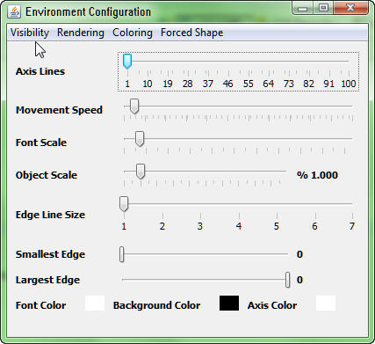
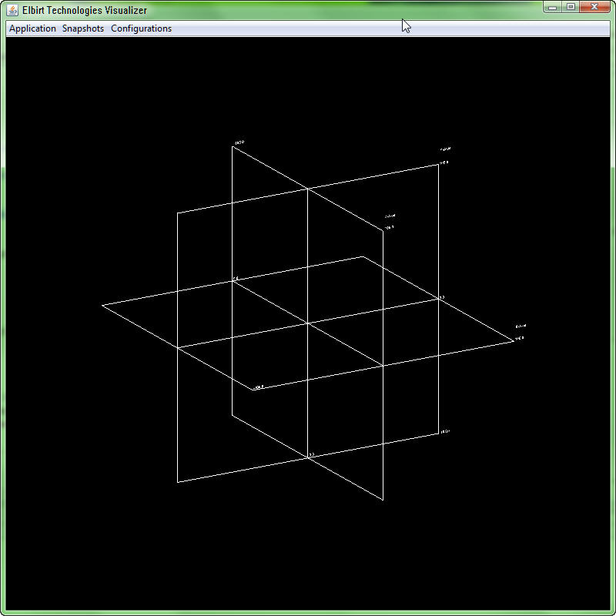
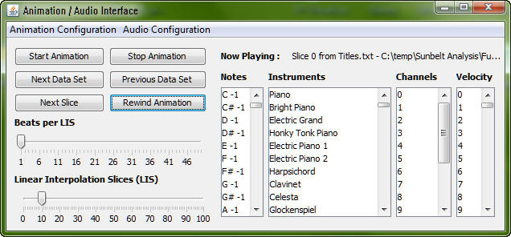
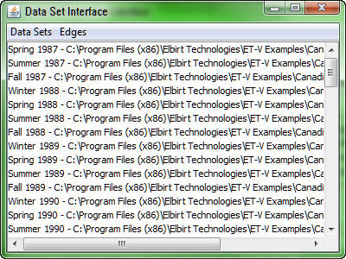
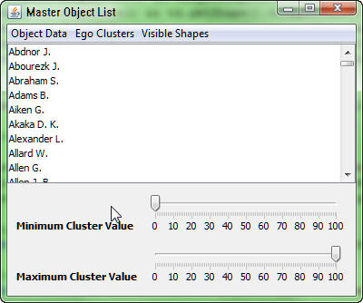
ET-V 1.0 The GUI Interface
Main GUI
Application Menu
Snapshot Menu
Continuous and Single Snapshot
Configuration
Access to other GUI
Environment Configuration
General Settings
Data Set Interface
Data I/O, Visibility and General Settings
Master Object List
Individual Object Controls
Ego Clustering
Shape Visibility
Animation/Audio Interface
Animation looping, fading and variable list.
Audio controls for forced valuation.

Slide 18
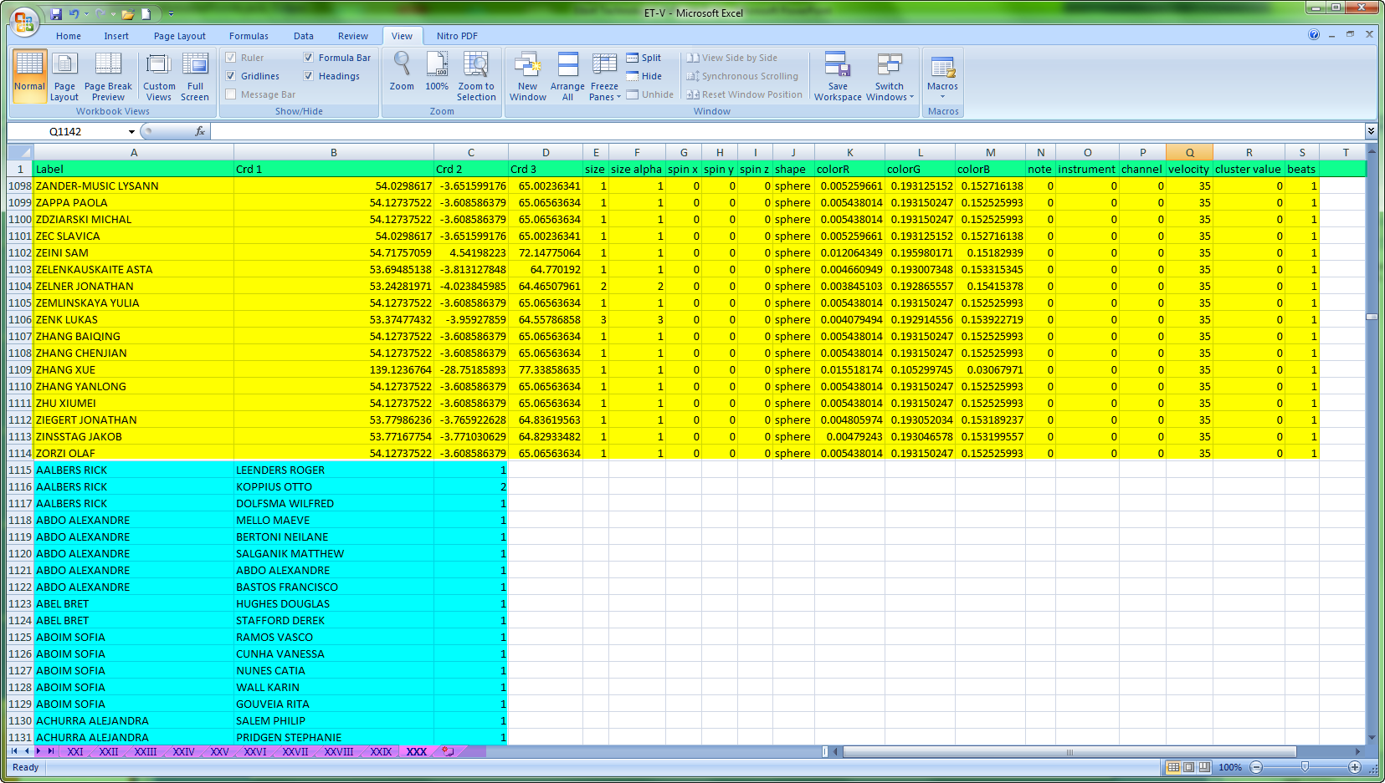
ET-V 1.0 The Input File
Fixed order Column Labels
Multiple Data Sets
Relation Pair Data
Object Attribute Data

Slide 19
Examples : Canadian Migration
Barnett & Sung, 2003
Spring 1987 – Spring 2005 Quarterly (73)
Spring, Winter, Summer, Fall
Size of Object = Population
Intonation = Mean Migration
Look / Listen for the Introduction of NANUVET Fall 1996

Slide 20
Examples : Senate Co-Sponsorship
Fowler 2010
93rd – 109th Congress (16)
Republicans, Democrats and Independents
Size of Object = Number of Bills Sponsored
Non-Sphere Shapes for Party Leaders
Watch for the Party Change event.
Watch for the development of the party line.

Slide 21
Examples : Sunbelt Co-Authorship
Abstract Data 2001 through 2010 Inclusive (XXI – XXX).
3406 distinct Authors over 10 years.
Author Participation over Time
Years | Authors | Cumulative Sum
10 | 5 | 5
9 | 17 | 22
8 | 13 | 35
7 | 29 | 64
6 | 34 | 98
5 | 59 | 157
4 | 122 | 279
3 | 222 | 501
2 | 498 | 999
1 | 2407 | 3406

Slide 22
Bibliography
Algorithmics Group. MDSJ: Java Library for Multidimensional Scaling (Version 0.2). Available at http://www.inf.uni-konstanz.de/algo/software/mdsj/. University of Konstanz, 2009. Brandes, U. and Pich, C., Eigensolver Methods for Progressive Multidimensional Scaling of Large Data. Proc. 14th Intl. Symp. * Graph Drawing (GD 06). LNCS 4372, pp. 42-53. Springer-Verlag, 2007.
Barnett, G. A., & Sung, E. J. (2003). An examination of Canada's Interprovincial Networks. Sunbelt Social Networks Conference. Cancun, Mexico. Fowler, J. H. (2006). Connecting the Congress: A Study of Cosponsorship Networks. Political Analysis , 14(4), 456-487.
Brandes, U. and Pich, C., Eigensolver Methods for Progressive Multidimensional Scaling of Large Data. Proc. 14th Intl. Symp. * Graph Drawing (GD ’06). LNCS 4372, pp. 42-53. ©Springer-Verlag, 2007.
Fowler, J. H. (2010, September 22). Cosponsorship Network Data Page. Retrieved October 4, 2010, from James H. Fowler Cosponsorship Network Data Page: http://jhfowler.ucsd.edu/cosponsorship.htm
Gothel, S. (2010). JOGL - Java Open Bindings for OpenGL. Retrieved October 5, 2010, from JogAmp:http://jogamp.org/jogl/www/
J. Madadhain, D. Fisher, P. Smyth, S. White, Y. B. Boey (2005). "Analysis and visualization of network data using JUNG". Journal of Statistical Software: 125. http://citeseerx.ist.psu.edu/viewdoc/download?doi=10.1.1.101.3015&rep=rep1&type=pdf.
Schonemann, Peter H., A generalized solution of the orthogonal Procrustes problem. Psychometrika, 1966, 31, 1-10.
TeleGeography. TeleGeography Report and Database. Available at http://www.telegeography.com/. Primetrica Inc., 2010.
Truevision TGA. (2010, August 20). Retrieved October 5, 2010, from Wikipedia:http://en.wikipedia.org/wiki/Truevision_TGA
Woelfel, J. and E. L. Fink (1980). The Measurement of Communication Processes: Galileo Theory and Method. New York, Academic

